Slide 1
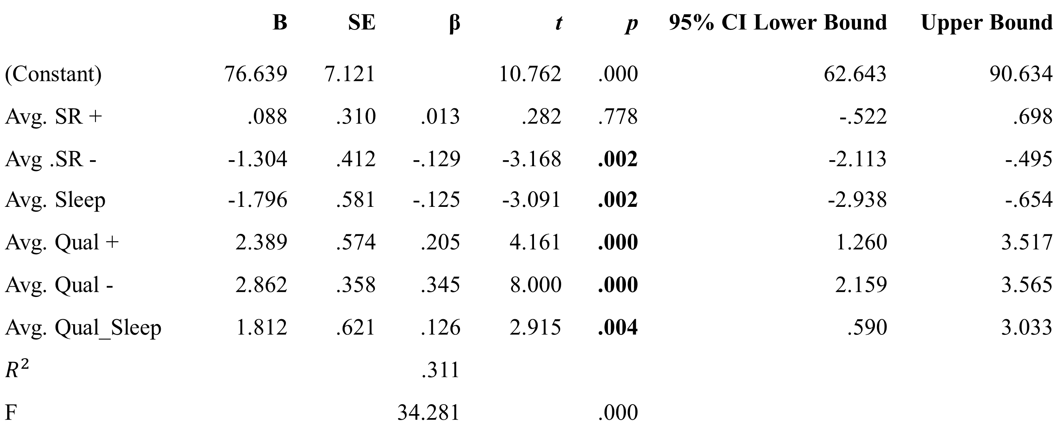
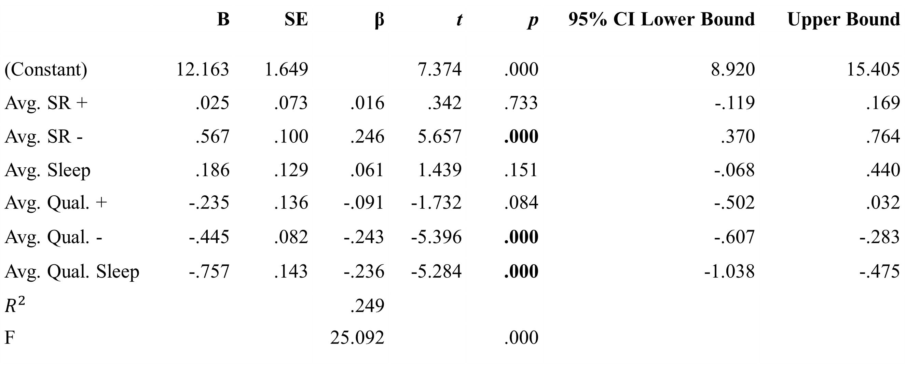
Time allocation as a translational process in contextual behavioral science Cory E. Stanton, M.S. (University of Nevada-Reno) & Thomas J. Waltz, Ph.D. (Eastern Michigan University)
Introduction
Results
One of the goals of contextual behavioral science is to foster meaningful dialogue between basic and applied scientists, and to develop coordinated research programs of common behavioral processes (Hayes et al., 2013).
The matching law (Herrnstein, 1961) is a robust finding from the experimental analysis of behavior, and has been linked to contextual analyses of depression.
The present study attempted to measure time allocation (Baum & Rachlin, 1969), an extension of the matching law, from the perspective of valued activities. The goal was to examine whether a novel self-report measure of time allocation predicted depression scores.
Multiple Regression of the Time Allocation Task on PHQ-9 Scores
 | B | SE | β | t | p | 95% CI Lower Bound | Upper Bound
(Constant) | 12.163 | 1.649 |  | 7.374 | .000 | 8.920 | 15.405
Avg. SR + | .025 | .073 | .016 | .342 | .733 | -.119 | .169
Avg. SR - | .567 | .100 | .246 | 5.657 | .000 | .370 | .764
Avg. Sleep | .186 | .129 | .061 | 1.439 | .151 | -.068 | .440
Avg. Qual. + | -.235 | .136 | -.091 | -1.732 | .084 | -.502 | .032
Avg. Qual. - | -.445 | .082 | -.243 | -5.396 | .000 | -.607 | -.283
Avg. Qual. Sleep | -.757 | .143 | -.236 | -5.284 | .000 | -1.038 | -.475
$$R^{2}$$ |  |  | .249
F |  |  | 25.092 |  | .000
Method
Three outlier sweeps were conducted based on standardized residuals, Cook’s d, and leverage values. 27 multivariate outliers (5.8%) were removed.
Undergraduate students at a Midwestern university completed a battery of self-report measures, including the Time Allocation Task (TAT), via Qualtrics. Measures included:
PHQ-9
BADS
AAQ-2 (10 item version; 7 item reported for these analyses)
VQ
SF-36
5-item Adjusting Delay Discounting Task
TAT
For the TAT, participants reported their time spent on meaningful activities, managing life’s negatives, and sleep for each of the previous seven days. They also provided subjective quality ratings (1-10) of their time spent in these domains. The measure was downloaded as an Excel spreadsheet and emailed to the first author.
This poster reports the following analyses:
Multiple regression of the TAT on PHQ-9 scores
Multiple regression of the TAT on BADS scores
One-way ANOVA of the TAT scores on different PHQ-9 groupings as defined by Arrol et al. (2010)
Convergent validity with the AAQ-2
Multiple Regression of the Time Allocation Task on BADS Scores
 | B | SE | β | t | p | 95% CI Lower Bound | Upper Bound
(Constant) | 76.639 | 7.121 |  | 10.762 | .000 | 62.643 | 90.634
Avg. SR + | .088 | .310 | .013 | .282 | .778 | -.522 | .698
Avg .SR - | -1.304 | .412 | -.129 | -3.168 | .002 | -2.113 | -.495
Avg. Sleep | -1.796 | .581 | -.125 | -3.091 | .002 | -2.938 | -.654
Avg. Qual + | 2.389 | .574 | .205 | 4.161 | .000 | 1.260 | 3.517
Avg. Qual - | 2.862 | .358 | .345 | 8.000 | .000 | 2.159 | 3.565
Avg. Qual_Sleep | 1.812 | .621 | .126 | 2.915 | .004 | .590 | 3.033
$$R^{2}$$ |  |  | .311
F |  |  | 34.281 |  | .000
Discussion
The TAT demonstrated some predictive validity in estimating depression. It also demonstrated convergent validity with other measures, though these correlations were modest. Further iteration is needed before employing it in research or clinical settings.
Managing life’s negatives, and the effectiveness of that time, were related to the AAQ-2 in theoretically expected directions. However, the magnitude of those relationships was small.
Three outlier sweeps were conducted based on standardized residuals, Cook’s d, and leverage values. 19 multivariate outliers (4.1%) were removed.
One-way ANOVA of Time Allocation of PHQ-9 Groupings
References
 | Not Dep. (n = 343) | Mild (n = 77) | Moderate (n = 32) | Severe (n = 11) | F | p |  | $$ω^{2}$$
Average SR+ | 5.79 | 5.20 | 5.01 | 4.48 | 1.603 | .188 | .003
Average SR- | 1.97 | 2.85 | 3.43 | 4.38 | 8.963 | <.001 | .049
Average Sleep | 8.65 | 8.98 | 8.68 | 8.45 | .895 | .444 | .000
Average Quality of SR+ | 6.92 | 6.05 | 5.41 | 5.46 | 10.920 | <.001 | .060
Average Quality of SR- | 6.08 | 4.46 | 4.39 | 4.80 | 11.495 | <.001 | .063
Average Quality of Sleep | 6.86 | 6.02 | 5.58 | 4.76 | 17.527 | <.001 | .096
Arroll, B., et al. (2010). Validation of PHQ-2 and PHQ-9 to screen for major depression in the primary care population. Annals of Family Medicine, 8(4), 348-353.
Baum, W.M., & Rachlin, H.C. (1969). Choice as time allocation. Journal of the Experimental Analysis of Behavior, 12(6), 861-874.
George, D., & Mallery, P. (2001). SPSS for Windows. Needham Heights, MA: Allyn & Bacon.
Hayes, S.C., Long, D.M., Levin, M.E., & Follette, W.C. (2013). Treatment development: Can we find a better way? Clinical Psychology Review, 33(7), 870-882.
Herrnstein, R.J. (1961). Relative and absolute strength of response as a function of frequency of reinforcement. Journal of the Experimental Analysis of Behavior, 4(3), 267-272.
474 out of 945 survey completers returned a Time Allocation Task with some interpretable data.
Listwise deletion (due to missing data) set the initial n for analyses at 463.
Continuous variables were within +/- 2 on skewness (George & Mallery, 2001).
Collinearity diagnostics were within acceptable limits.
Email comments to: corystanton@nevada.unr.edu

